Slide 1
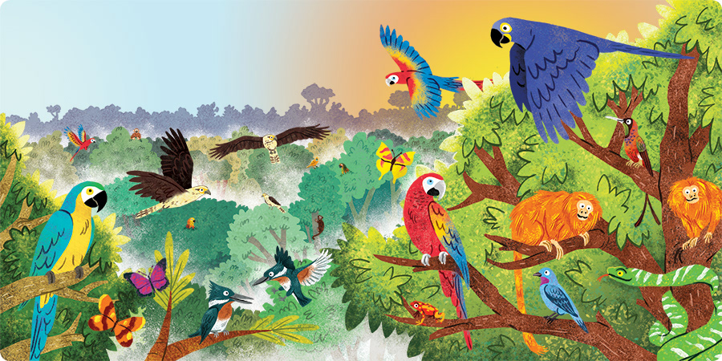
English
Students will study The Breadwinner, a text about a girl living in Afghanistan under the Taliban. They will develop their analysis skills, link their reading to the world around them, and use this text as a stimulus for original writing.
History
Students will study the transatlantic slave trade, exploring the origins of triangular trade, the experiences of enslaved people, and the abolition of slavery. They will link their learning to issues of modern slavery.
Reading
In their reading lessons students will develop their key reading skills of inference, selecting evidence, analysing language and summarising a text. They will start with an anthology of non-fiction about the natural world and those who explore the natural world, then move on to extracts of interest in half term 2.
Science
Students will study how humans obtain useful resources from the Earth, in particular how metals are extracted from the earth and purified ready for use. They will also study how and why it is important to use our Earth’s resources in a sustainable way.
Maths
Students are developing their number skills, working on rounding numbers to whole numbers and various decimal places. They will also develop their ability to use the mathematical operations to a range of numbers.
The World Around Us
Topic Overview
Geography
Students will study tropical rainforests, looking in detail at the Amazon rainforest as a case study. They will learn about the features of a tropical rainforest, how humans and animals survive and thrive in the rainforests, and how rainforests can be managed sustainably.
Citizenship
Students will be exploring the question ‘what rights should all children have?’ This includes the right to an education and the right to access healthcare. Students will be encouraged to consider their rights and the rights of others.
PSHE
In PSHE students will be learning about digital literacy and online safety. They will also learn about how to be safe online and about age restrictions online.
Art
Students will be studying colour theory in PE, learning about tones, tints and shades; how to mix colours.
RE
Students will be introduced to the concept of creation stories and explore different beliefs about creation. They will consider how beliefs in creation stories might affect how religious people care for our world. Finally they will explore how strong religious arguments for design are.

