Slide 1
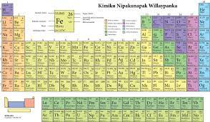
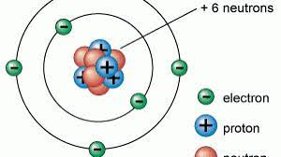
Bishopton Science Department
Welcome to Year 10 Combined Science : Trilogy!
Spring Term 2
Key Terms:
Proton, neutron, electron, molecule, ion, electron shell, groups, periods, periodic table, Dalton, Mendeleev, Plum pudding
Revision at KS4
There are ample revision materials on Century Learning bespoke to your childs
https://www.bbc.co.uk/bitesize/guides/zw2gpbk/revision/1
App.century.tech
https://www.youtube.com/watch?v=TYEYEIuTmGQ
What will your child be learning?
During this half term students will learn that the periodic table provides chemists with a structured organisation of the known chemical elements from which they can make sense of their physical and chemical properties. The historical development of the periodic table and models of atomic structure provide good examples of how scientific ideas and explanations develop over time as new evidence emerges. The arrangement of elements in the modern periodic table can be explained in terms of atomic structure which provides evidence for the model of a nuclear atom with electrons in energy levels..
How you know your
child is making progress.
Student work will be
assessed through verbal and written feedback, where they will be given feedback on their strengths and suggested improvements to
further improve their knowledge and understanding.
Students will be expected to engage with teacher feedback and make improvements to their work.
What will students be assessed on?
Students will be assessed on their ability to demonstrate knowledge and understanding of: scientific ideas; scientific techniques and procedures, their application of knowledge and understanding of: scientific ideas; scientific enquiry, techniques and procedures. And their ability to analyse information and ideas to: interpret and evaluate; make judgments and draw conclusions; develop and improve experimental procedures

Slide 2
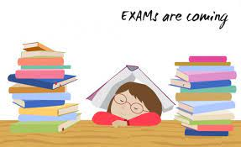
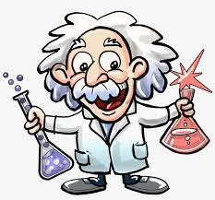
Bishopton Science Department
Welcome to Year 11 Combined Science: Trilogy!
Spring Term 2
What will your child be learning?
Year 11 continue to work towards their summer examinations. They are completing revision materials and past papers in preparation for their forth coming exams.
Exam Dates
Biology Paper 1 17 May 2022 AM
Chemistry Paper 1 27 May 2022 AM
Physics Paper 1 9 June 2022 PM
Biology Paper 2 15 June 2022 AM
Chemistry Paper 2 20 June 2022 AM
Physics Paper 2 23 June 2022 AM
How you know your
child is making progress.
Student work will be
Assessed through verbal and written feedback, where they will be given feedback on their strengths and suggested improvements to
further improve their knowledge and understanding. Students will be expected to engage with teacher feedback and make improvements to their work.
Students will also be involved in a termly review of their progress and will be expected to take part in mock examinations leading up to their GCSEs.
What will students be assessed on?
Students will be assessed on their ability to demonstrate knowledge and understanding of: scientific ideas; scientific techniques and procedures, their application of knowledge and understanding of: scientific ideas; scientific enquiry, techniques and procedures. And their ability to analyse information and ideas to: interpret and evaluate; make judgments and draw conclusions; develop and improve experimental procedures
Further Reading
To encourage our students to keep up their reading, we want them to read more widely and to read more often. Therefore we have launched our Reading Passport Programme.
To support this you could talk to your child about the number of stamps they are receiving in their passport! Stamps will be awarded for completing a range of reading related activities. Once the passport has been completed, and reviewed by our Literacy Lead and Head teacher, a prize will be awarded to recognise your child’s efforts.
Revision at KS4
There are ample revision materials on Century Learning bespoke to your childs
App.century.tech

